Slide 1
URTICARIA
John McDonnell, MD

Slide 2
CASE 1
29-year-old otherwise healthy female with itchy hives, particularly with cold exposures
Her father has had similar episodes

Slide 3
Which test is most likely to confirm her diagnosis?
A) cryoglobulins
B) ice cube challenge
C) phospholipase C (PLC) gene sequencing
D) autologous serum skin test

Slide 4
CASE 2
26 yr old female with severe asthma and urticaria x4 years
Failed antihistamines
Started on omalizumab 1 year ago and hive-free since first injection
However, now having systemic reactions on the medication

Slide 5
Which is your next step?
A) IVIG trial
B) Go back on high-dose antihistamines
C) Omalizumab desensitization
D) Trial of mepolizumab

Slide 6
URTICARIA

Slide 7
Background
Common (10-20% have at least one episode)
Duration of symptoms important
Acute = <6 weeks
Often spontaneously remit
More common in kids
Chronic = >6 weeks
Sometimes spontaneously remit
Rarely can identify cause
More common in women

Slide 8
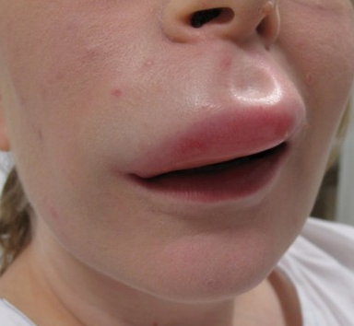
Angioedema
May be associated with chronic urticaria
Swelling of lips and tongue
Often suggests more significant disease

Slide 9
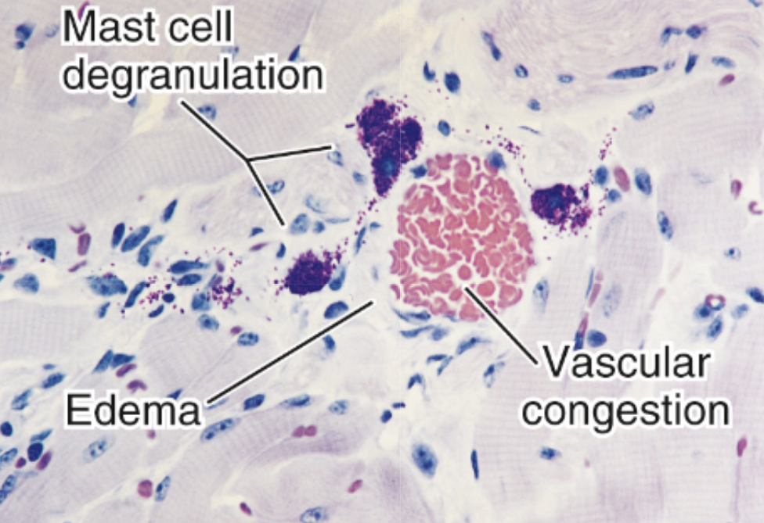
Pathogenesis of Urticaria
Thought to be mediated by mast cells and basophils
IgE is an important player

Slide 10
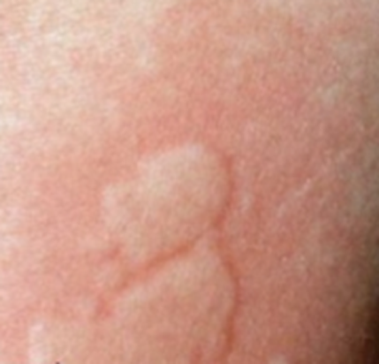
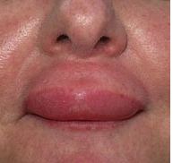
Clinical presentation
Wheal and flare reactions
Itching or burning
Last up to 24 hours, skin returns to normal
Angioedema (sometimes)
Antihistamines help

Slide 11
Physical/inducible urticarias
Dermatographic
Cholinergic
Solar
Vibratory
Cold
Aquagenic
Exercise-Induced
Pressure (delayed)

Slide 12
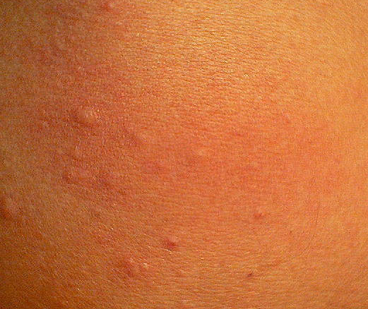
Cholinergic urticaria
Pinpoint (1-3 mm) hives, surrounded by large flares
Common provoking factors: hot baths/showers sweating, emotional factors, exercise
Dx: heat/exercise challenge

Slide 13
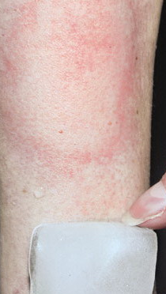
Cold urticaria
Pruritus/swelling confined to cold-exposed areas
Hand swelling when holding cold objects
Lip/pharyngeal symptoms when ingesting cold foods/beverages
Symptoms generally maximal after exposed skin is rewarmed

Slide 14
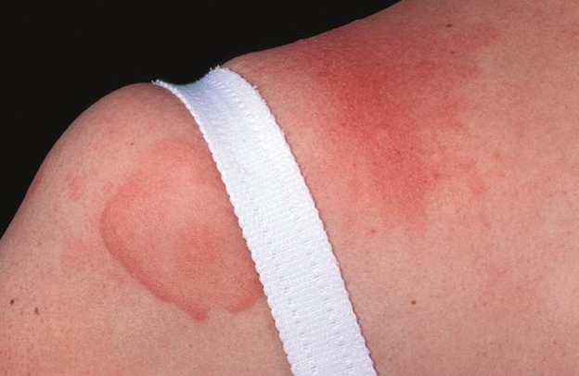
Physical urticaria – who cares?
Physical urticaria tends to have a longer duration of illness
Chronic idiopathic urticaria (CIU) with concomitant physical urticaria/angioedema syndrome may be less responsive to conventional pharmacotherapy than CIU alone

Slide 15
Diagnostic work up
Extensive general screening or workup for rare causes not recommended
No improvement in patient outcomes, cost/benefit not favorable
Testing for Type 1 aeroallergens or food allergens not warranted

Slide 16
Labs
Consensus: Limited lab evaluation to rule out an infectious, autoimmune, or endocrine disorder
CBC with differential, ESR/CRP, TSH
Provocation tests for inducible urticaria

Slide 17
Skin biopsy
Appropriate for more atypical presentations:
Systemic features
Long-lasting hives
Painful hives
Bruising

Slide 18
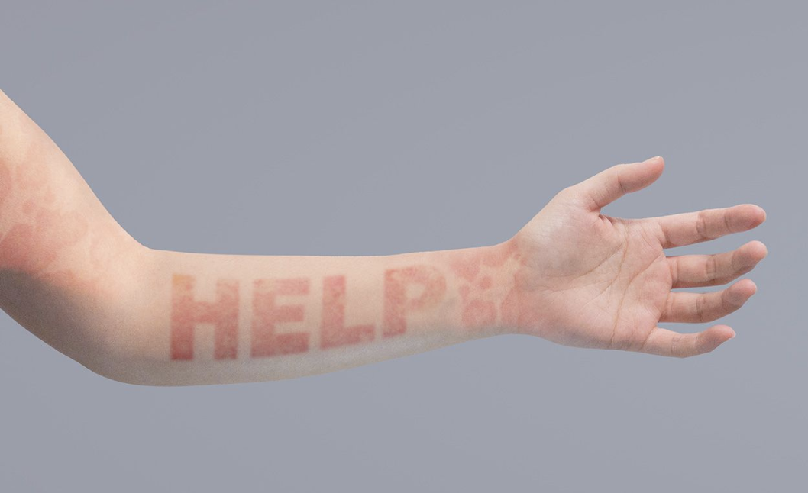
Management
Goal – control symptoms. VERY debilitating for some
Lifestyle changes
Avoid triggers for inducible urticaria
Discontinue medications that can possibly worsen CIU
Decrease alcohol

Slide 19
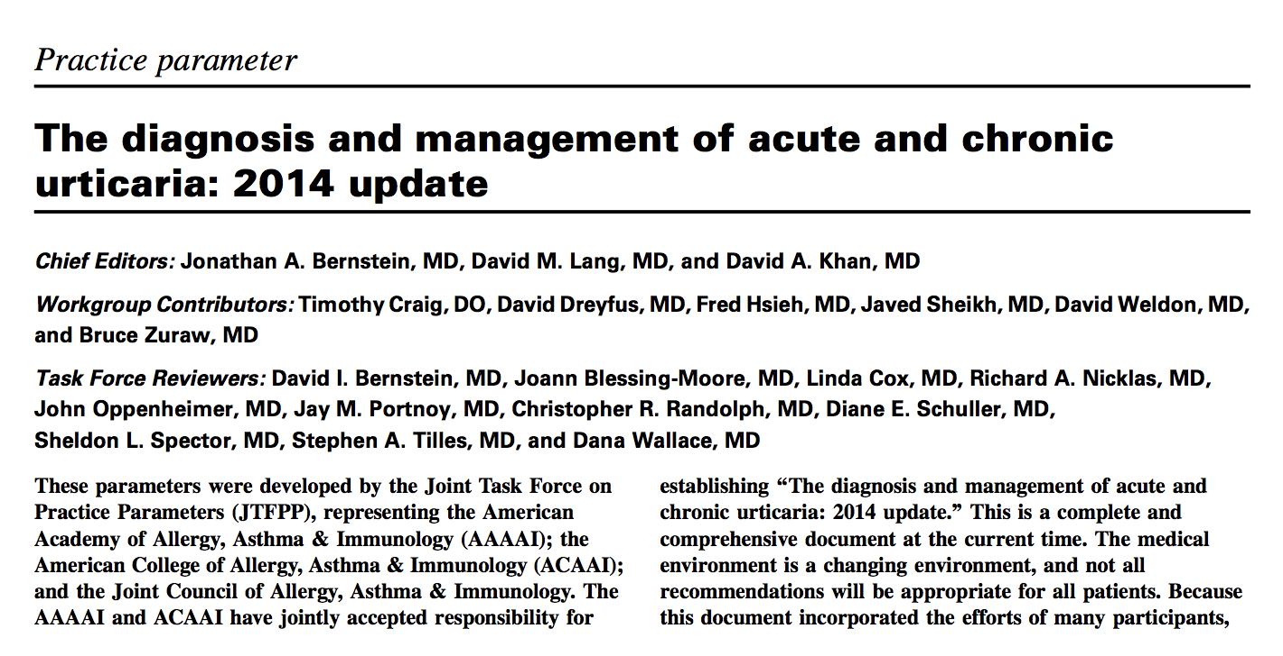
H1 antihistamines
First-line therapy for CU
Prefer second generation – less sedating
4X normal dosing

Slide 20
Other standard treatments
- In addition to H1 blockers . . .
H2 blockers?
Montelukast?
Doxepin or Hydroxyzine?

Slide 21
Corticosteroids
Topical corticosteroids ineffective
Systemic corticosteroids not recommended

Slide 22
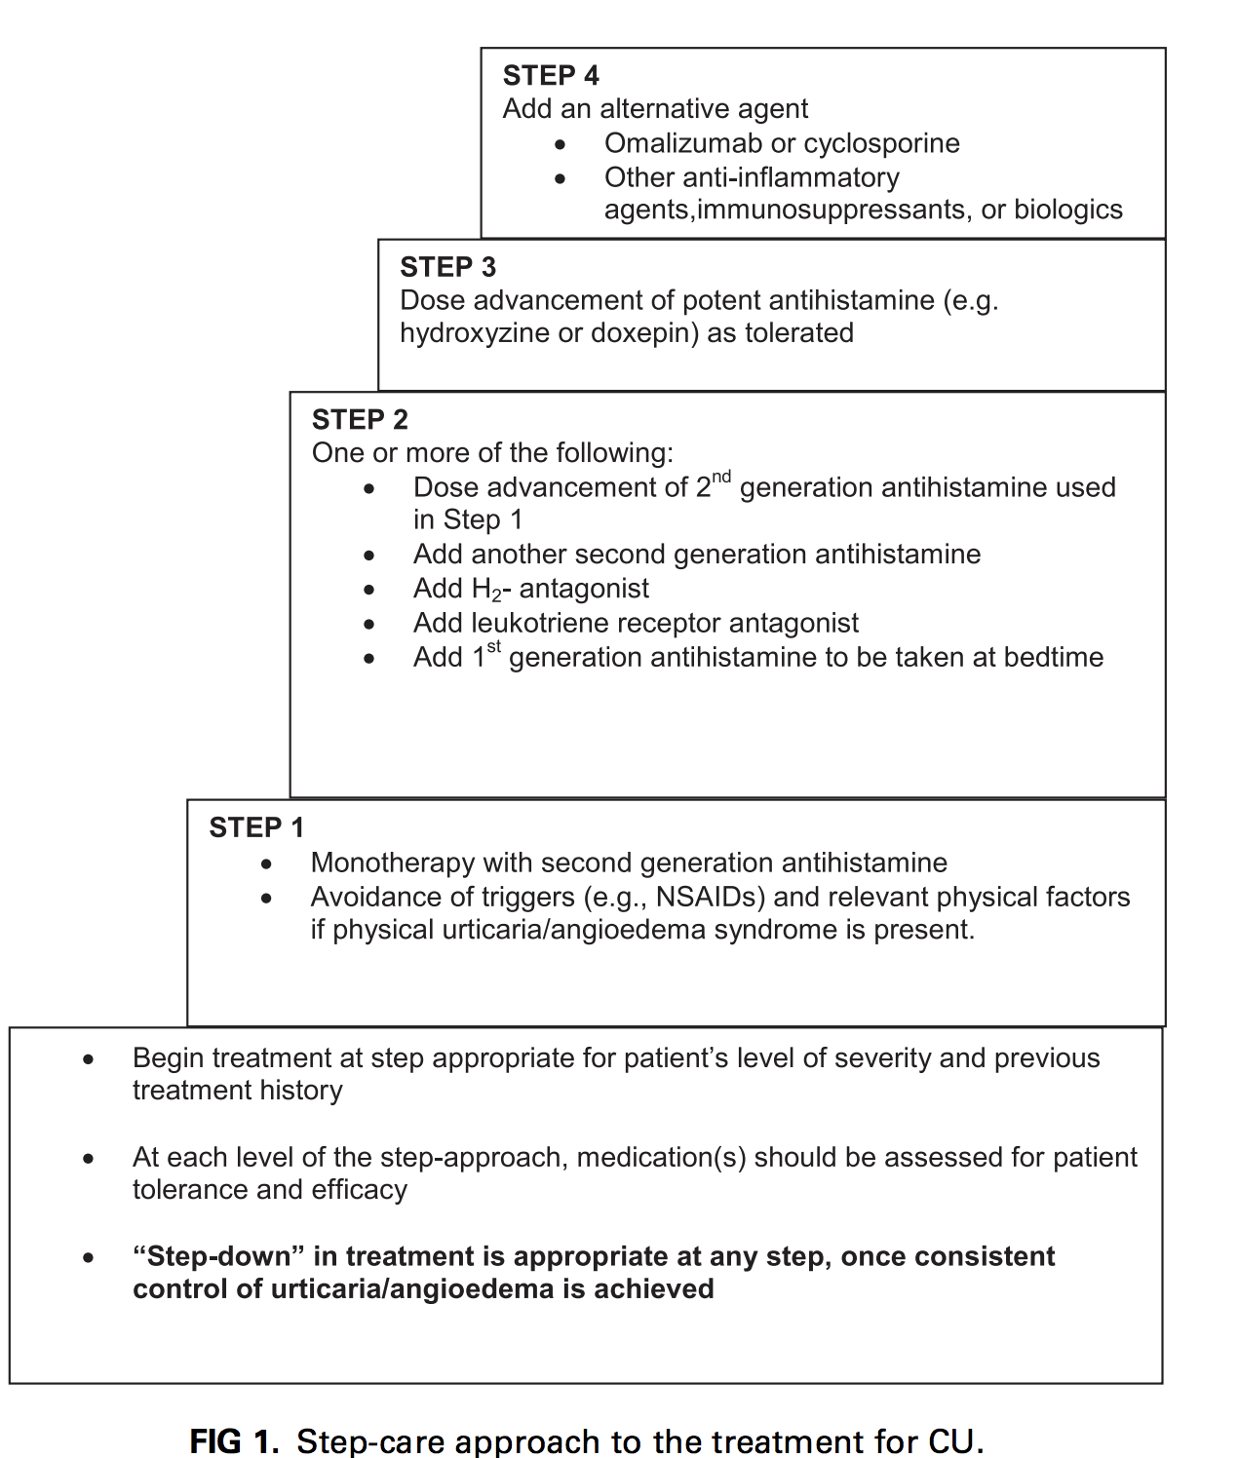

Slide 23
Options for refractory disease
Dapsone
Sulfasalazine
Hydroxychloroquine
Cyclosporine
Omalizumab

Slide 24
Omalizumab
IgG monoclonal antibody to IgE
Therapy of choice for refractory disease
Effective and safe, works quickly
Good for comorbid asthma

Slide 25
Omalizumab problems
Anaphylaxis
1-2 per 1000 patients
Carry epinephrine to injections
CV disease (not really)
Malignancy (not really)
Issues with discontinuation

Slide 26
Omalizumab-Dosages
Effective doses: 150 – 300 mg per month
300 mg improved all endpoints
150 mg improved all endpoints except angioedema

Slide 27
CASE 1
29-year-old otherwise healthy female with itchy hives, particularly with cold exposures
Her father has had similar episodes

Slide 28
Which test is most likely to confirm her diagnosis?
A) cryoglobulins
B) ice cube challenge
C) phospholipase C (PLC) gene sequencing
D) autologous serum skin test

Slide 29
CASE 2
26 yr old female with severe asthma and urticaria x4 years
Failed antihistamines
Started on omalizumab 1 year ago and hive-free since first injection
However, now having systemic reactions on the medication

Slide 30
Which is your next step?
A) IVIG trial
B) Go back on high-dose antihistamines
C) Omalizumab desensitization
D) Trial of mepolizumab

